Slide 1
Integration testing and Spring Boot test support
45426: Teste e Qualidade de Software
Ilídio Oliveira
v2025-10-01

Slide 2
Learning objectives
Relate the test of API with the right level of testing in the “pyramid of tests”
Justify the need for “slicing” test scopes.
Discuss diferente strategies to test layered applications in Spring Boot.
Read SpringBoot tests with mocking of dependencies.

Slide 3
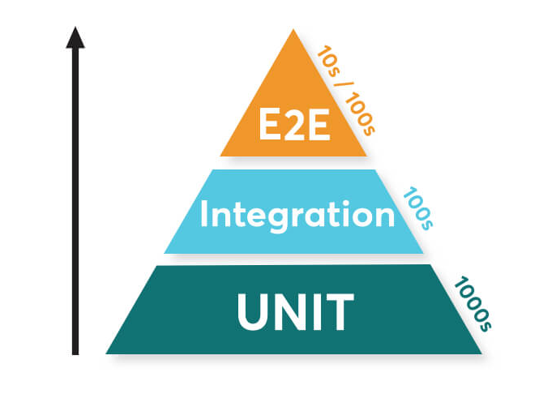
Recall test scopes
Is my API endpoint to search top monthly performing employees working as expected?
JUnit engine
Assertions libraries
Mockito

Slide 4
Spring Boot framework
Enterprise applications:
  Server deployed
  Business critical
  Database-intensive (often several data sources)
  Multi-user (concurrent sessions, transactions,…)
Developer view:
  Full-stack development in Java
  Often: backend in Spring Boot + JavaScript frontend
  Widely use, mature framework
Spring Boot paradigms
  “classic” Web MVC (thread-per-request model)
  WebFlux (reactive programming, event-driven)
  Cloud (handle micro-services in high-availability deployments)

Slide 5
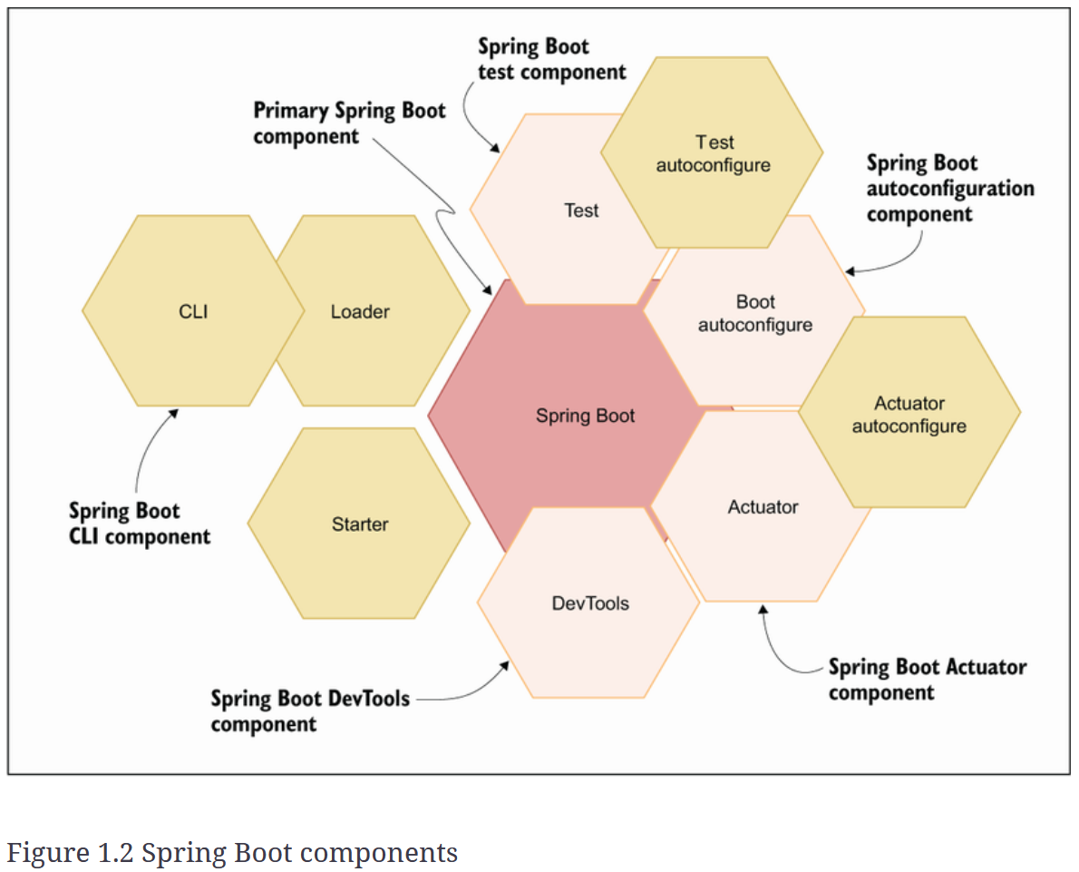
Spring Boot includes several modules

Slide 6
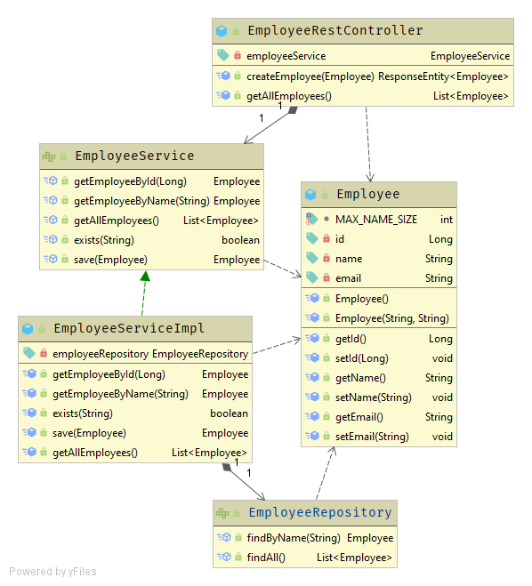


SB typical layers
Boundary
(e.g.: REST API)
Data entity
Bizz logic
(services)
Data access w/ JPA
https://learning.oreilly.com/library/view/domain-driven-design-tackling/0321125215/
BD

Slide 7
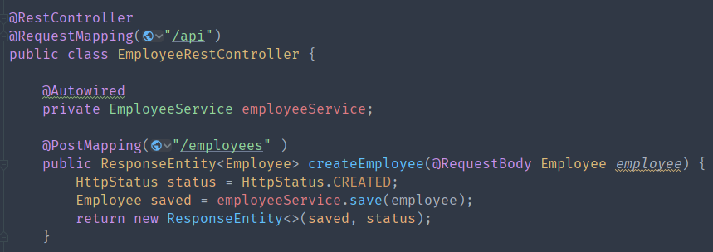
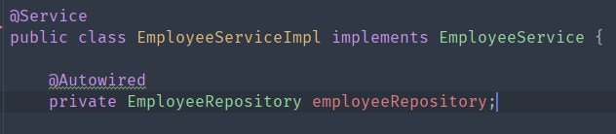
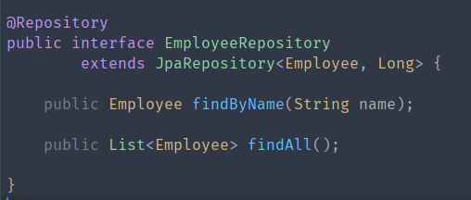


Boundary
Domain logic
Note that the use of @Autowire is deprecated; DI should be moved to constructor level.
Data access

Slide 8
Spring Boot components
Components registration
  In each layer, we have various components.
  Simply put, to detect them automatically, Spring uses classpath scanning and annotations.
  Then, it registers each component in the ApplicationContext.
A few of these annotations:
  @Component: generic stereotype for any Spring-managed component
  @Service: “components” meant to be used at the service (domain) layer
  @Repository: classes at the persistence layer, which will act as a database repository
  @Service and @Repository are subtypes of @Component.

Slide 9

Spring Boot includes several modules

Slide 10
Spring Boot testing
  A helper framework used to simplify the creation of Spring Framework apps
Provides:
  Curated dependencies
  “Starter” configurations (data, web, testing,…)
  “Opinionated” auto-configuration of many components
  Can run most tests without starting an external web container

Slide 11
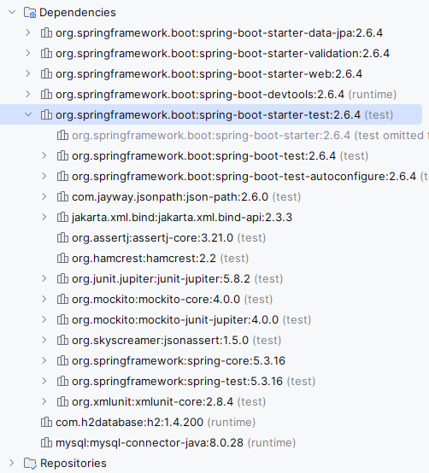
Extending SB philosophy to testing
Test features enabled with
spring-boot-starter-test
Starter provides:
Convenient testing dependencies
Testing auto-config

Slide 12
Test scope #1
  Scenario:
  call the REST-endpoint and verify behavior
  full-scope integration test
BD

Slide 13
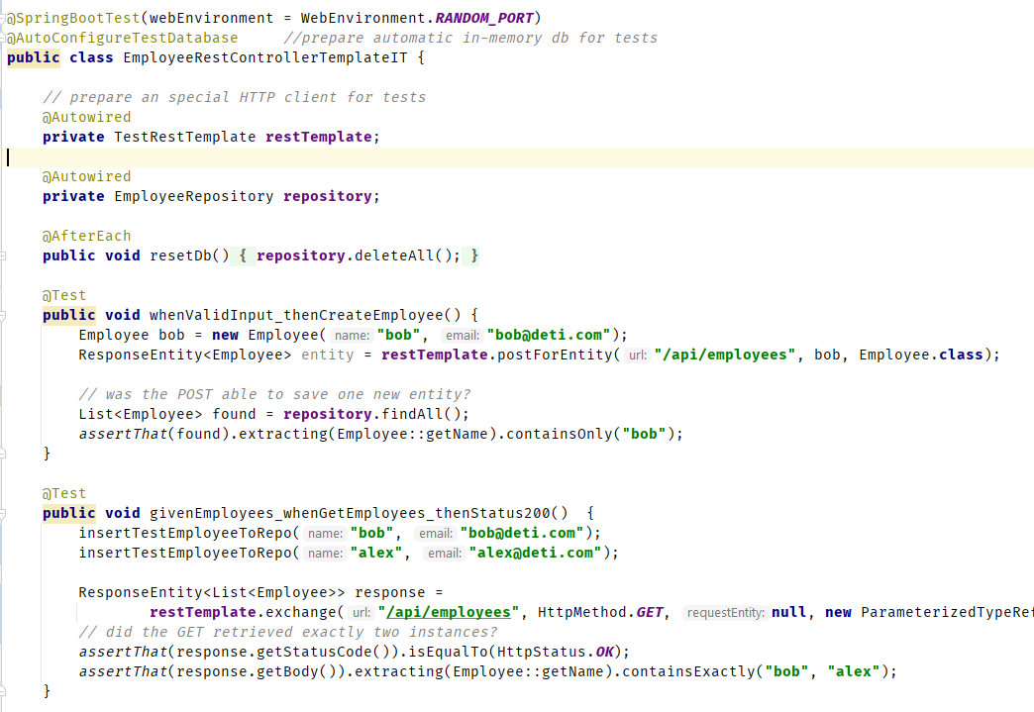



Testing the REST controller (full stack, web server started)

Slide 14
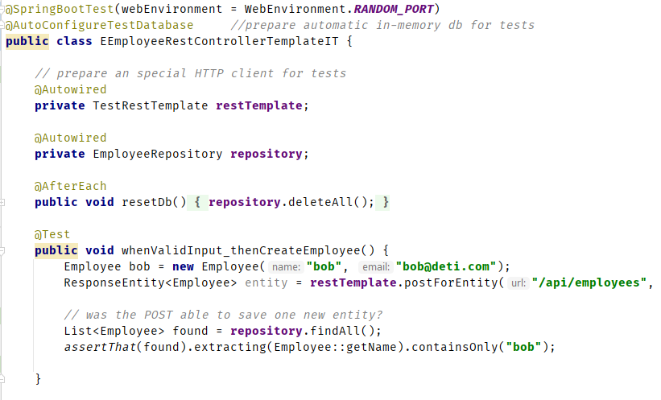
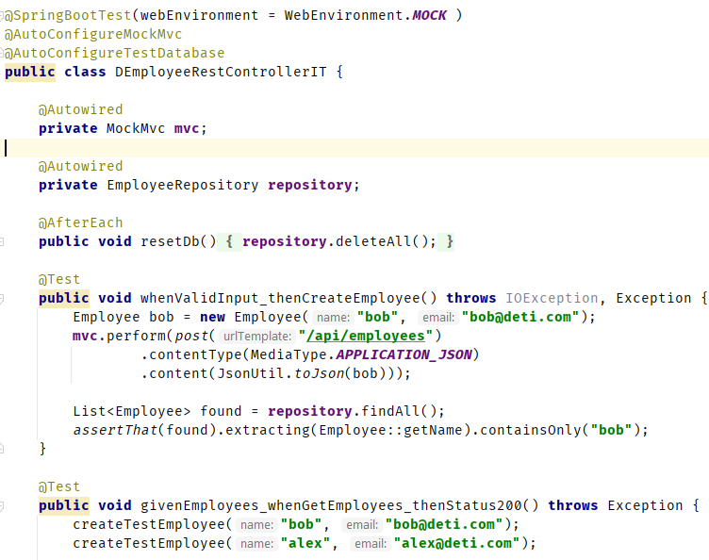
Interact w/ controller using a REST client
Optionally use a mocked servlet environment
Interact w/ controller using the MockMvc interface
Another useful approach is not starting the application server at all but to test in a simplified version of the web layer, in which SB handles the incoming HTTP request and hands it off to your controller. (Most of the stack is used; your code will be called in the same way; removes the cost of starting the server.)

Slide 15
@SpringBootTest
@SpringBootTest annotation
  Enable FULL context, using all available auto configurations
  Heavy!
  vs. limit Application Context to a set of SB components that participate in test scenario, by listing them (with annotations)
Slicing the test context
  Only load slices of functionality when testing DB
  @xxxxxTest at class level, e.g.: @DataJpaTest
  @DataMongoTest,
  @WebMvcTest,…

Slide 16
Test scope #2: controller
  Scenario:
  Test the boundary (Controller)
  Focus on REST contract: path expressions, parameters, JSON,…
  Requires: EmployeeService bean
  Strategy:
  Enable web MVC in a simplified environment
  Mock Service behavior [note: we are mocking a SB component behavior, not a regular class…]
BD

Slide 17
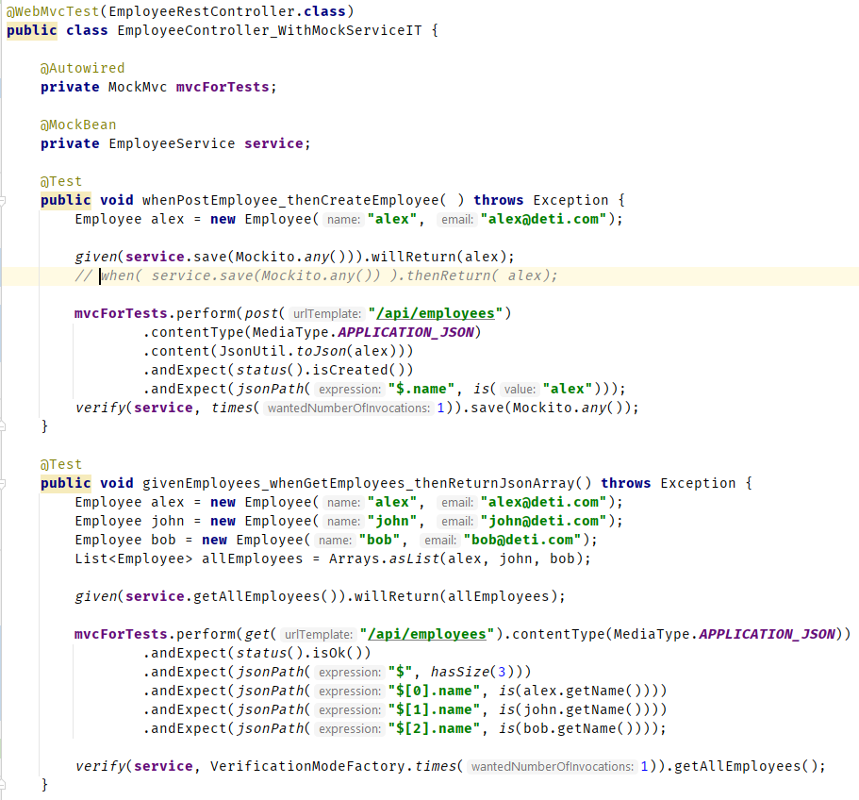

MockMvc
Only loads the EmployeeRestController component
Instead of loading dependencies (EmployeeService ), we may mock them

Slide 18


Test scope #3: service/domain logic
  Scenario:
  Test the Service
  Focus on bizz logic and “high level” data use
  Strategy:
  Make the test a standard JUnit test
  Mock dependencies on the data source provider (Repository)
BD

Slide 19
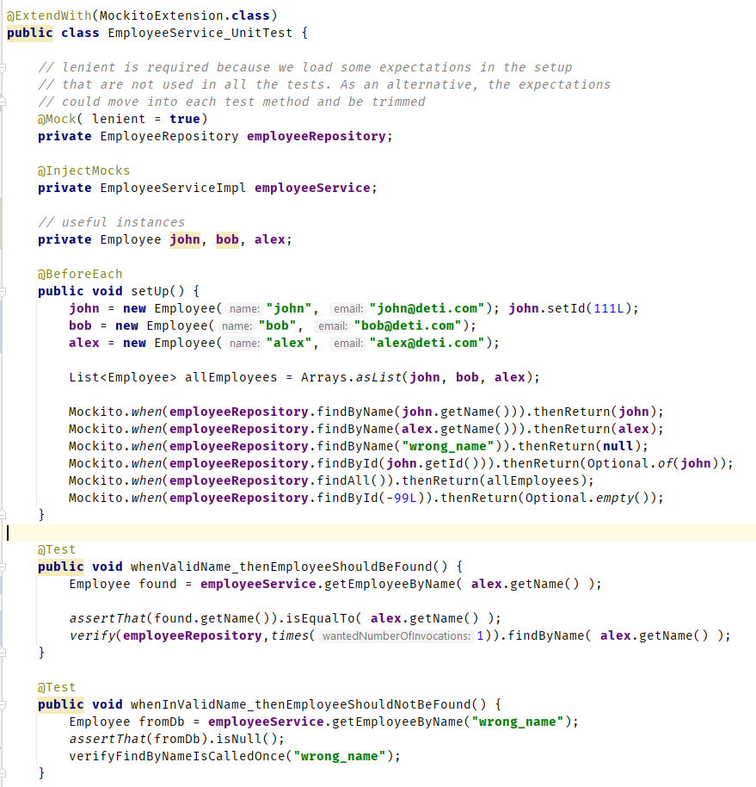


Mock repository access

Slide 20

Test scope #4: data layer (JPA)
  Scenario:
  Test the data access interface
  Focus on complex queries
  Strategy:
  Load only JPA-related instrumentation
  Use TestEntityManager
BD

Slide 21
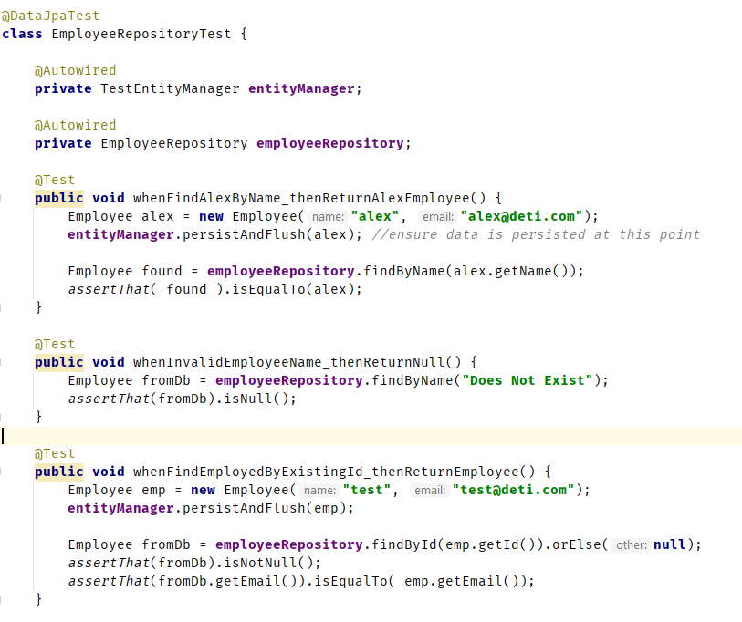


Focus on JPA data access methods

Slide 22
References
Spring.io docs
  Testing the web layer
Eugen Paraschiv’s tutorials
  Testing in Spring Boot

